Slide 1
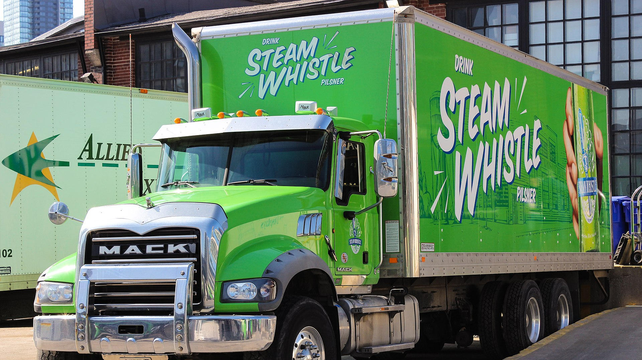

IFTA Strategic Plan & Strategic Planning Process

Slide 2
Strategic Plan Working Group
2

Slide 3
IFTA Strategic Plan Working Group Members
Volunteers
  Daniel Yeh (IA)
  Marcy Liberatore (NC)
  Mark Leahy (NB)
  Kelly Heaton (AR)
  Paul Nilsen (WI)
  Mason Simpson (TN)
  Amanda Cirillo (RI)
  Jackie Polk (Lee Trans)
AAC Volunteers
  Jonathan Puryear (NC)
  Michael Copeland (OK)
Chairs
  Margie Hughes – Comdata
  Dawn Gunter – FL
Board Liaisons
  Darrin Gerry (SD)
  Christie Chewning (NC)
  James Ackroyd (AB)
IFTA, Inc. Advisors
  Carmen Martorana
  Debora Meise

Slide 4
Process
    Task 1: Project Kickoff Meeting (Virtual)
    Task 2: SWOT Analysis (Virtual)
    Task 3: Research Existing & Emerging Topics
    Task 4: In-person workshop (Louisville)
      Mission and Vision
      Goals
      Strategies
    Task 5: Tactics Workshop (Virtual)
    Task 6: Written Strategic & Implementation Plan
    Task 7: Project Updates and Reviews
    Task 8: Strategic Plan Workshop (Virtual)

Slide 5

Project Approach
Previous Strategic Plan was created in 2019
  Task list for Original Strategic Plan was completed
  New Strategic Plan solicited as Original Plan lifecycle ended
Kentucky Transportation Center Approach
  Utilizes Technology of Participation (ToP) methodology
  Facilitator acts as neutral arbiter of ideas
  Blend of in-person and virtual planning sessions
Information Provided to IFTA SPWG Ahead of July Meeting
  Top 5 Emerging Issues for IFTA
  Initial IFTA Past, Present and Future Survey Results
5

Slide 6

Top 5 Emerging Issues for IFTA, Inc.
6

Slide 7
Top 5 Emerging Issues for IFTA, Inc.
Development of zero-emission trucks (e.g., hybrid-, electric-, or hydrogen-based) along with connected and automated vehicle technologies
Development of new technologies (e.g. AI, alternative fueling infrastructure, and unique electric identifiers)
Adoption of alternative fuel taxes in the United States and Canada
Ongoing modifications to the structural, regulatory, and organizational environments of IFTA, Inc.’s member jurisdictions
The trucking industry and general public’s response to emerging technological, policy, regulatory, and highway funding changes

Slide 8
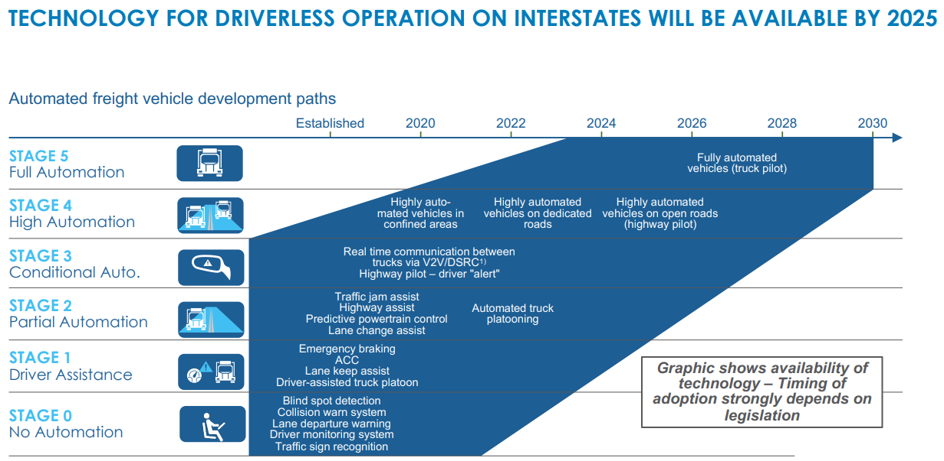
Autonomous Trucks
Autonomous Truck Implementation Timeline (Source: ERTRAC, Roland Berger, J.B. Hunt)
8
Notes:
Autonomous Trucks
Trucking industry stakeholders are very interested in the development of driverless vehicles. Early industry projections anticipated trucks with Level 5 automation (i.e., full self-driving) on all public roads by 2030, but these forecasts are unlikely to materialize due to industry volatility. Nonetheless, firms are moving forward with testing of driverless trucks. For example, a 2024 test pilot spearheaded by Aurora and Uber Freight was successful, and now the companies planning to deploy a fleet of 10 Level 4 trucks in 2025 to complete terminal-to-terminal trips between Dallas and Houston along Interstate 45.Long-term projections of market share for autonomous trucks vary. Forecasts suggest that by 2035 between 100,000 and 700,000 of these vehicles could be on U.S. roads, depending on the speed of technological progress and adoption rates.
Woodruff, G., & Loftus, J. (2022). Automated Vehicle Technologies in CMV's Southeast CMV Safety Research Summit, Tuscaloosa, AL. https://www.caps.ua.edu/wp-content/uploads/2022/05/WOODRUFF_LOFTUS-CMV-AV-lunch-session.pdf
Hawkins, Andrew J. 2024. “Uber and Aurora announce ‘long-term’ driverless truck deal after successful pilot.” The Verge. Accessed 1 April 2025 at: https://www.theverge.com/2024/6/25/24184973/uber-freight-aurora-driverless-truck-deal
Bellan, Rebecca. 2024. “Aurora Innovation delays commercial autonomous truck launch to 2025.” TechCrunch. Accessed 1 April 2025 at: https://techcrunch.com/2024/10/30/aurora-innovation-delays-commercial-autonomous-truck-launch-to-2025/
Woodruff, G., & Loftus, J. (2022).

Slide 9
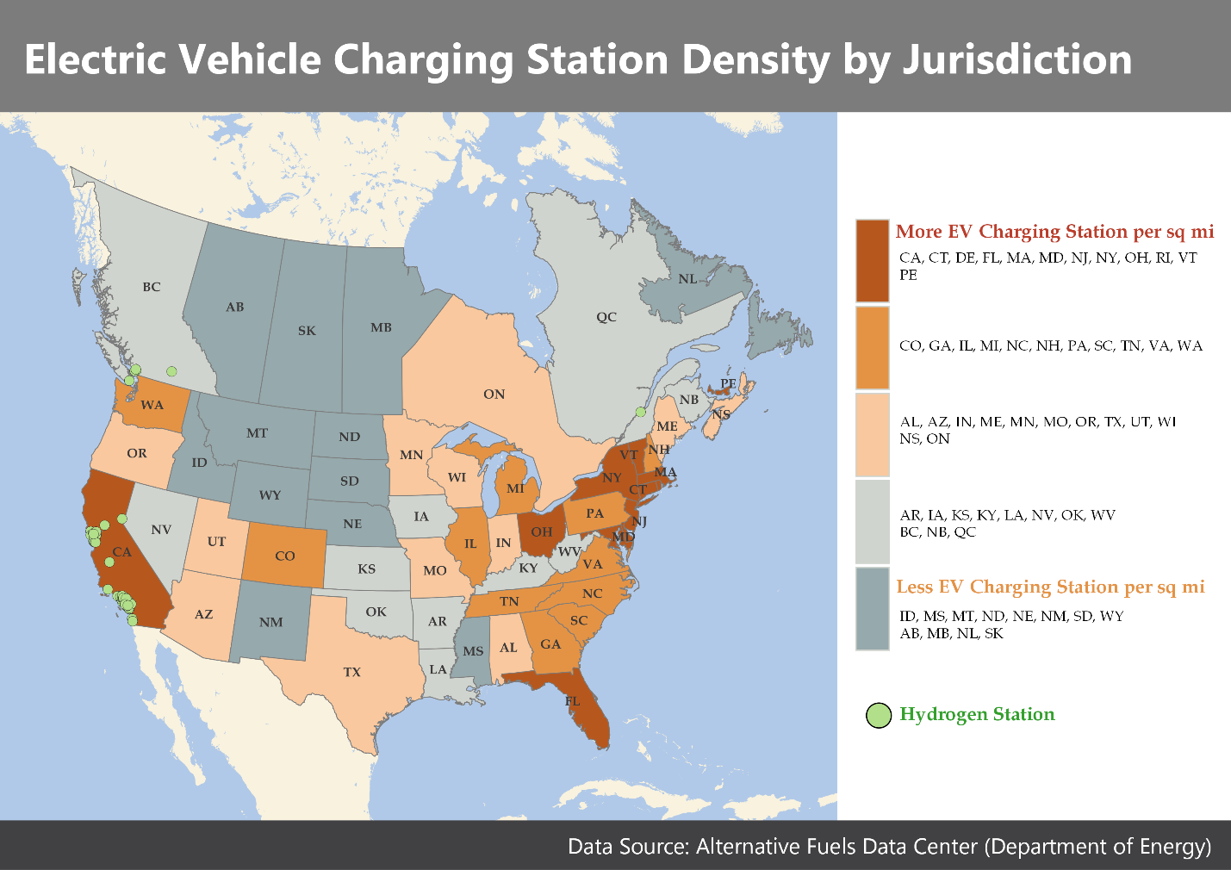
Electric Vehicle Public Fueling Stations by Density(Stations per 1,000 square miles), 2024

Slide 10
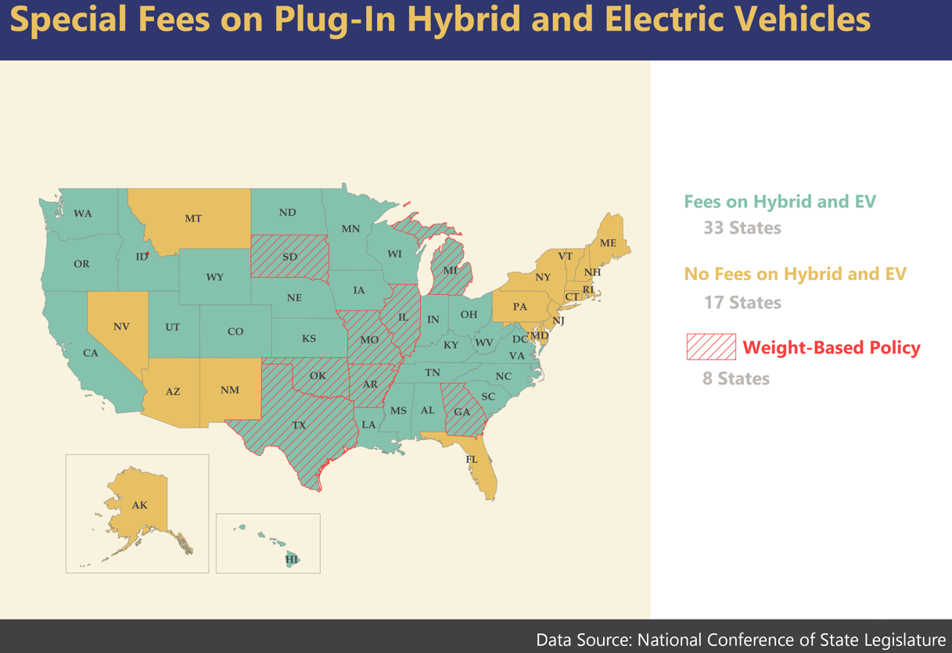
States with Special Fees for Hybrid and Electric Vehicles, 2023

Slide 11
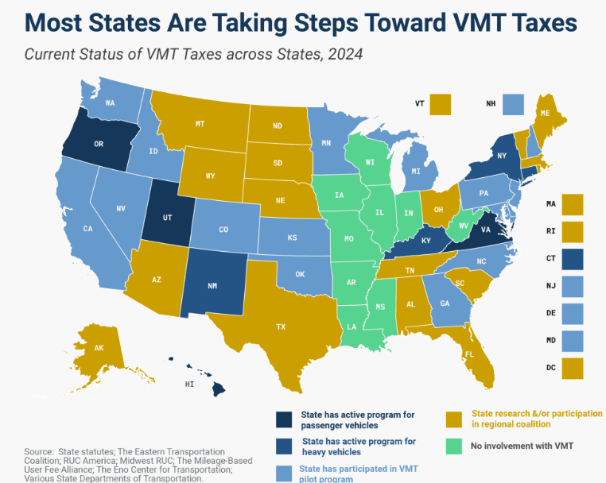
State MBUF Program Status, 2024 (Source: Tax Foundation)

Slide 12
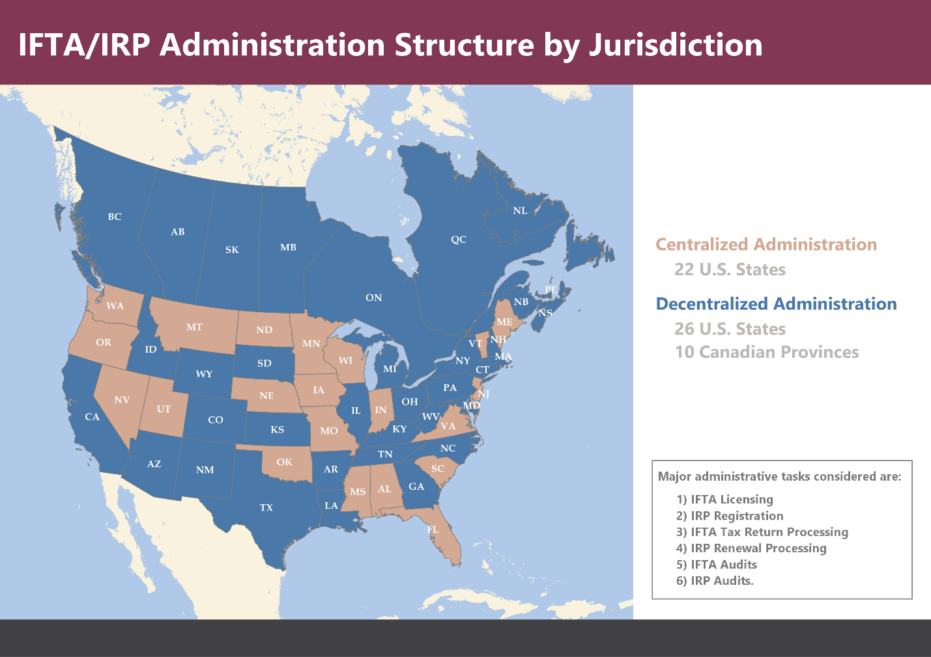
IFTA/IRP Administrative Structure by IFTA Jurisdiction, 2024

Slide 13
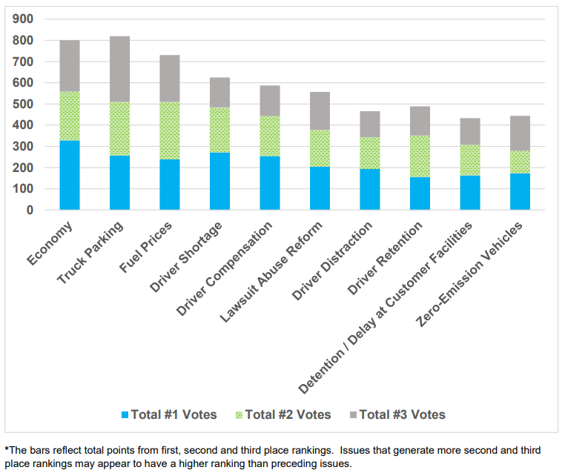
Distribution of Industry Issue Prioritization Scores
Source: American Trucking Association, 2023

Slide 14
IFTA Past, Present & Future Survey
14

Slide 15
IFTA Past, Present & Future Survey
Survey sent to IFTA stakeholders:
  IFTA staff members in jurisdictions
  IFTA, Inc. staff
  Industry professionals
  Members of the IFTA Board of Trustees
  Members of the IFTA Strategic Planning Working Group
  Other stakeholders (e.g., law enforcement agencies)
Two survey periods:
  Period 1
    May 9 to May 31, 2024
  Period 2
    June 3 to July 10, 2024
Survey composition:
  7 open-ended questions
  2 multiple-choice questions
15

Slide 16
IFTA Current Reality Survey Responses and Progress Demographics
Period | Responses | Percentage
1 | 241 | 62.6
2 | 144 | 37.4
Total | 385 | 100%
16

Slide 17
Distribution of Responses/Ideas by Survey Question
Question | 1 Idea | 2 Ideas | 3 Ideas | N/A | % Respondents with Ideas | Total Respondents | Total Ideas
1 | 14 | 21 | 45 | 305 | 26.2% | 80 | 191
2 | 20 | 11 | 46 | 308 | 25.0% | 77 | 180
3 | 8 | 19 | 47 | 311 | 23.8% | 74 | 187
4 | 15 | 12 | 43 | 315 | 22.2% | 70 | 168
5 | 14 | 17 | 38 | 316 | 21.8% | 69 | 162
6 | 11 | 15 | 37 | 322 | 19.6% | 63 | 152
Total |  |  |  |  |  |  | 1040
17

Slide 18
Respondent Professional Backgrounds
Stakeholder | Period 1 (n) | Period 1 (%) | Period 2 (n) | Period 2 (%) | Total (n) | Total (%)
IFTA Board Member | 1 | 1.7 | 1 | 3.3 | 2 | 2.2
IFTA Member Jurisdiction | 44 | 73.3 | 21 | 70.0 | 65 | 72.2
IFTA Staff | 6 | 10.0 | 3 | 10.0 | 9 | 10.0
Industry Professional | 4 | 6.7 | 4 | 13.3 | 8 | 8.9
Other | 4 | 6.7 | 1 | 3.3 | 5 | 5.6
SPWG Member | 1 | 1.7 | 0 | 0.0 | 1 | 1.1
Total | 60 | 100 | 30 | 100 | 90 | 100
18

Slide 19

Word Cloud for Question 1
What are three accomplishments of the organization over the last 3 – 5 years (important milestones, significant efforts, important areas of progress)?

Slide 20
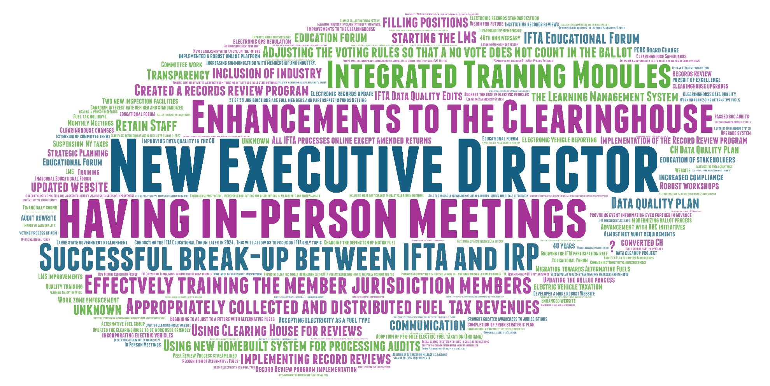
Phrase Cloud for Question 1
What are three accomplishments of the organization over the last 3 – 5 years (important milestones, significant efforts, important areas of progress)?

Slide 21
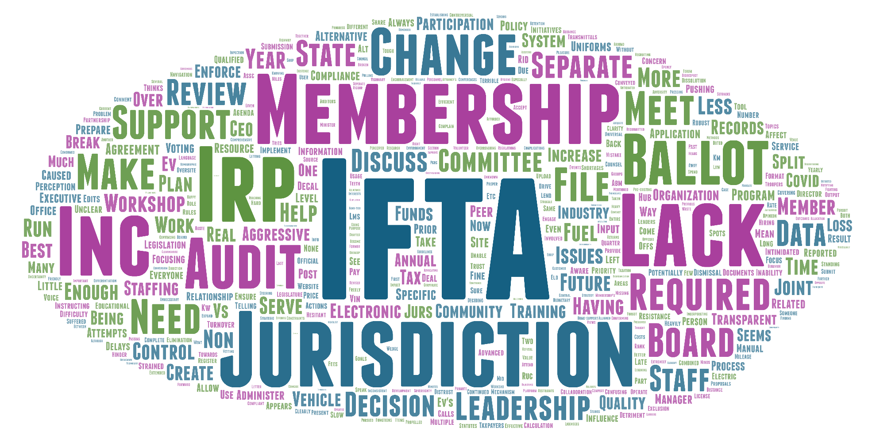
Word Cloud for Question 2
What are 3 setbacks (things that have impeded progress, intruded on plans)?

Slide 22
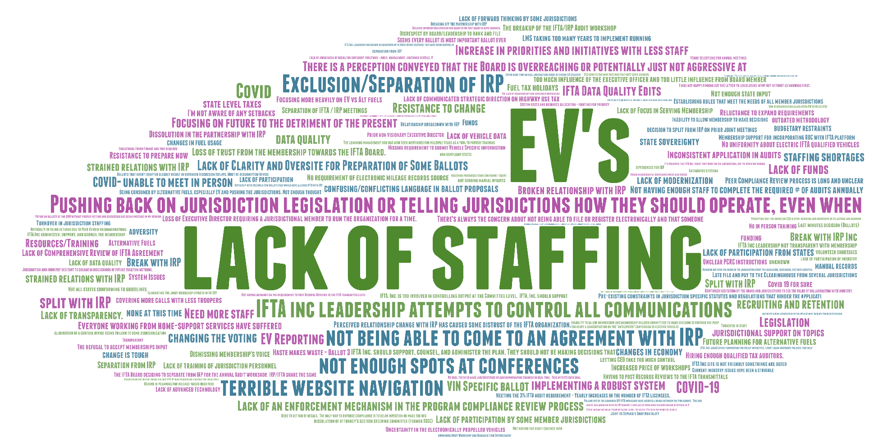
Phrase Cloud for Question 2
What are 3 setbacks (things that have impeded progress, intruded on plans)?

Slide 23
Effectiveness of IFTA, IFTA Current Reality Survey
Response | Period 1 (n) | Period 1 (%) | Period 2 (n) | Period 2 (%) | Total (n) | Total (%)
Very Ineffective | 0 | 0.0 | 2 | 6.5 | 2 | 2.2
Ineffective | 1 | 3.4 | 1 | 3.2 | 3 | 3.3
Neither Effective nor Ineffective | 7 | 11.9 | 8 | 25.8 | 15 | 16.7
Effective | 35 | 59.3 | 13 | 41.9 | 48 | 53.3
Very Effective | 15 | 25.4 | 7 | 22.6 | 22 | 24.4
Totals | 58 | 100.0 | 31 | 100.0 | 90 | 100.0

Slide 24
Survey Categorization
KTC researchers analyzed and coded answers to the open-ended questions
  Phase 1 responses only
  Most questions had categories for the following:
    IFTA Inc/IFTA jurisdiction programmatic issue
    IFTA Inc/IFTA jurisdiction policy issue
    IFTA Inc/IFTA jurisdiction IT issue
  Other categories as responses dictate
  e.g., Fuel Tax Issue/Policy
24

Slide 25
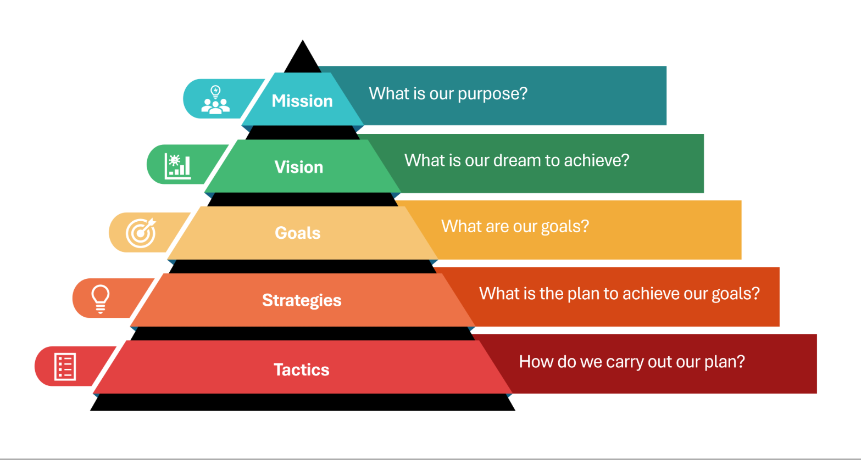
IFTA Strategic Planning Process

Slide 26
IFTA Mission Statement
Support member jurisdictions in the collection and distribution of taxes administered under the International Fuel Tax Agreement while strategizing to ensure sustainability.

Slide 27
IFTA Vision Statement
IFTA, Inc. facilitates equitable, efficient and uniform administration of the International Fuel Tax Agreement through collaboration, strategic innovation, education and responsiveness.

Slide 28

Goals, Strategies and Tactics

Slide 29
IFTA Goals
Goal
Foster Innovative Solutions
Maintain Operational Continuity
Monitor and Convey Emerging Issues
Retain Uniformity While Allowing Optional Tax Methodologies
Strengthen Stakeholder Engagement
Maintain and Enhance Communication

Slide 30
Foster Innovative Solutions
Scheduled Review of all Information Resources
Investigate and Propose Advancements to IT Systems
1.) Examine potential to connect with other partner organizations or agencies (FMCSA, UCR)
2.) Maintain current member list: Do email addresses match state? Kick back from defunct emails?
3.) Analyze user reports to LMS training modules to prioritize key vs static information
4.) Analyze other parts of IFTA website to prioritize key information
1.) Review user security protocols for IFTA
2.) Modernize IFTA Clearinghouse for possible system upgrades and enhancements
3.) Monitor and evaluate partner organizations’ IT enhancements for modifications that could benefit membership
4.) Evaluate the need for additional IT resources to adapt to changes in transportation funding methodologies
Goal
Strategy
Tactic

Slide 31
Foster Innovative Solutions
Investigate Data Quality
Develop Program for Jurisdictional Pilot Projects/Large Scale Changes
1.) Review data to identify who needs intervention before program compliance review
2.) Conduct periodic systematic review of IFTA Clearinghouse data quality
3.) Provide timely feedback to jurisdictions on data quality
4.) Provide quarterly updates of data issues to the IFTA, Inc. Board
5.) Enhance mechanisms for membership to analyze data
1.) Create mechanism to evaluate Cost/Benefit of participation
2.) Devote segment of IFTA newsletter to pilot project information
3.) Publish pilot project information on IFTA website
4.) Create a process to request IFTA participation in pilot projects
5.) Create a subcommittee to identify potential pilot project opportunities
Goal
Strategy
Tactic

Slide 32
Maintain Operational Continuity
Cross-Training and Succession Planning (IFTA and Jurisdiction Support)
Review of Educational Offerings
1.) Update/develop all job descriptions for IFTA, Inc.
2.) Establish written procedurals for each IFTA, Inc./BoT/Committee Chair position and review them periodically
3.) Identify cross-training or back-up procedures for IFTA Staff
4.) Develop general onboarding for new IFTA Commissioners, new committee members, and new general members
1.) Create a schedule to periodically review the catalog of offerings to remove any outdated classes
2.) Survey stakeholders to see if there are topics needed and not currently offered
3.) Draft a ballot to create/establish an educational committee that would work with LMS and Educational Forum curriculum development
Goal
Strategy
Tactic

Slide 33
Maintain Operational Continuity
Systematic Review of Governance Documents
Learning Management System Enhancement and Expansion
1.) Review committee composition, roles, responsibilities, and expectations
1.) Determine modules to update and then prioritization order
2.) Determine modules to create and then prioritization order
3.) Create a cadence for review of all modules for accuracy and timeliness
Goal
Strategy
Tactic
Periodically Catalog How Jurisdictions Govern IFTA
1.) Annual survey conducted to confirm/update how jurisdictions administer IFTA activities
2.) Create electronic repository for survey results

Slide 34
Monitor and Convey Emerging Issues
Conduct Perpetual Research on Legislative Action
Continue and Enhance our Presence in Outside Organizations on Road Use Funding Methodologies
1.) Create an electronic database of jurisdictional legislative proposals
2.) Provide jurisdictions with periodic legislative summaries created by the Attorney Advisory Committee
1.) Partner with ATA and state trucking associations for uniformity
2.) Investigate associate membership opportunities
3.) Develop marketing campaign to reach out to other agencies about IFTA activities and capabilities
4.) Selectively and intentionally invite outside organizations to IFTA meetings
Goal
Strategy
Tactic
Systematic Updates on Emerging Trends
1.) Explore various methods to communicate more frequently with stakeholders
2.) Utilize mass communication for emerging issues
3.) Determine frequency of communication about emerging trends

Slide 35
Retain Uniformity While Allowing Optional Tax Methodologies
Propose Modifications to the Agreement to Enable Flexibility in Adapting to Additional Revenue Structures
Support the Creation and Adoption of Model Legislation for Alternative Road Funding Methodologies
1.) Develop a charge for the alternative fuels committee to identify IFTA Agreement elements that need modification to allow flexibility
2.) Provide education to jurisdictions on modifications needed in the IFTA Agreement
3.) Proactively meet with jurisdictions to identify statutory or regulatory impacts to compliance with modified Agreement allowing alternative revenue structures
4.) Incorporate identified jurisdictional impacts into proposed ballot language
1.) Develop a best practice guide for using an IFTA platform for alternative road funding methods
2.) Identify a list of resources to assist with the education surrounding necessary legislative changes for alternative road funding methods
3.) Position IFTA, INC. as an expert on alternative roads funding methods
4.) Establish a committee to review jurisdictional legislation and analyze adjustments to allow for alternative road funding methods
Goal
Strategy
Tactic

Slide 36
Retain Uniformity While Allowing Optional Tax Methodologies
Advocate for the IFTA Platform to serve as The Solution for Alternative Revenue Structures
Collaborate with Stakeholders to maintain a Federal Mandate requiring continued Compliance with the IFTA Agreement as Revenue Methods Evolve
1.) Provide a pilot/software for IFTA and non-IFTA to file alternative fuel taxes
2.) Develop a plan for public education campaigns
3.) Enhance collaboration efforts
1.) Collaborate with other transportation associations to maintain ISTEA Federal mandate
2.) Maintain participation in Federal System Alternative Advisory Board
3.) Show how IFTA can work in/with a mileage-based system
4.) Create awareness to keep ISTEA a Federal mandate
Goal
Strategy
Tactic

Slide 37
Strengthen Stakeholder Engagement
Maintain and Enhance our Tech Summit
1.) Move to a quarterly meeting format (three virtual and one in-person)
2.) Review working items and analyze changes to the mission and composition of the tech summit
3.) Ensure action items from meetings are assigned and addressed
Develop Participation Enhancement Plan
1.) Develop descriptions for volunteer positions
2.) Create friend of the committee role (introductory participation)
3.) Develop and maintain a list of "Rising Stars" to fill future roles
4.) Survey stakeholders about volunteering
Goal
Strategy
Tactic
Develop an Outreach Program and Tools
1.) Conference buddy program
2.) Develop 1:1 mentor program for new commissioners across jurisdictions
3.) Develop 1:1 Mentor programs for staff positions across jurisdictions

Slide 38
Strengthen Stakeholder Engagement
Encourage Involvement from all Stakeholders (Jurisdiction, Industry, Roles, Experience)
Encourage IFTA Event Attendance
1.) Adjust event planning to expand capacity
2.) Make meetings more active and interactive
3.) Increase and expand publicity for events
4.) Continue to utilize a group for event planning with multiple content creators
1.) Define value, parameters, and expectations of roles
2.) Utilize regular survey of stakeholders to determine interest in involvement
3.) Maintain database of interested stakeholders to tap as volunteers
Goal
Strategy
Tactic

Slide 39
Maintain and Enhance Communication
Enhance LEO Related Communication
Increase Transparency of Board of Trustees
1.) Create One-Stop-Shop data sharing for law enforcement
2.) Develop means for LEO feedback and input
3.) Develop law enforcement impact report
4.) Devote IFTA newsletter section to LEO stakeholders
1.) Limit topics for closed session BOT (Ex. HR discussions)
2.) Actively encourage attendance at open BOT meetings
3.) Post BOT meeting minutes for non-Board members within 60 days of meetings
4.) Actively encourage interaction with BOT members
Goal
Strategy
Tactic

Slide 40
Maintain and Enhance Communication
Investigate Communication Methods
1.) Use analytics when available to help determine effective communications (SEO, etc.)
2.) Survey membership for preferred communication options/methods
3.) Research to see if specific roles (admin, audit, etc.) need additional or specialized communication
4.) Measure attendance of external stakeholders at IFTA events year-over-year
Goal
Strategy
Tactic

Slide 41
Strategic Planning Outcomes
New Mission and Vision Statements
Goals – 6
Strategies – 24
Tactics – 84
Implementation
  Next steps
41

Slide 42
Implementation
Tactics are the guide to implementation of this strategic plan.
Performance measures can be guided by a simple dichotomous measure of “Completed” or “Not Completed.”
  Continuous measurement and weights can also be employed as IFTA moves through the completion of various tactics.
42

Slide 43
Federal Transportation Grants
Three potential opportunities for research collaboration into safety and technology, revenues, and special topics that could assist IFTA with some of their future endeavors
  USDOT Strategic Innovation for Revenue Collection (SIRC)
  FMCSA High Priority grants (HP-ITD & HP-CMV)
  National Cooperative Highway Research Program (NCHRP)
43

Slide 44

End
Questions? Comments?
44

